Slide 1
Reaching to AWS Console and Try Amazon Comprehend and Rekognition
By
Burak G.

Slide 2
Login:
https://dashboard.eventengine.run/

Slide 3
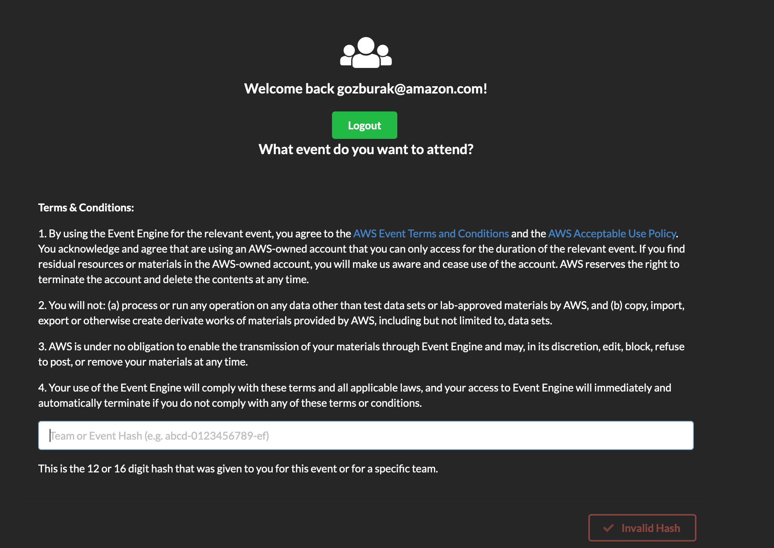
Copy-paste:
d21d-15f55995b4-05
Note:
This hash key may change. Please see slack channel for new hash keys if we start a new environment.

Slide 4
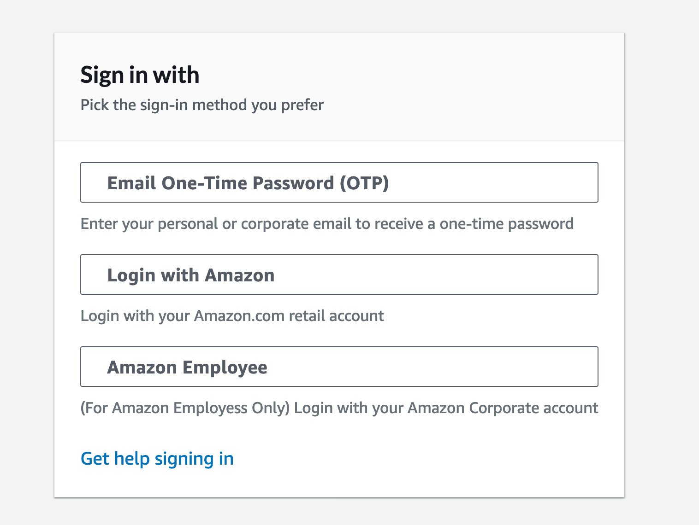
It will give you a one time password sent to your email

Slide 5
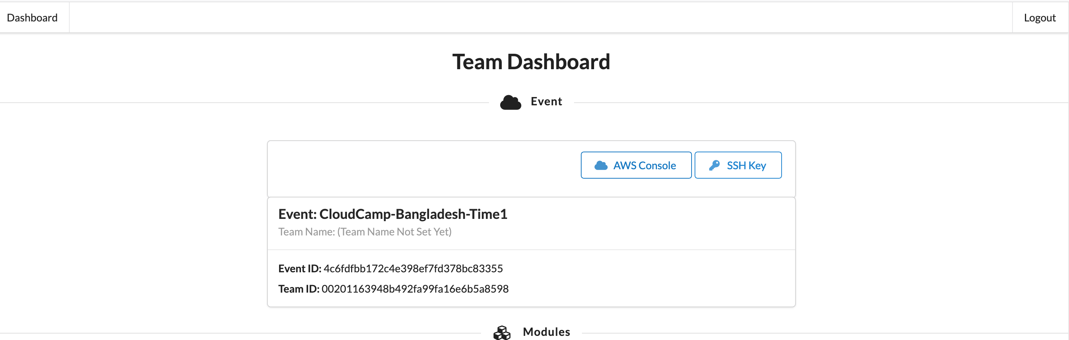
Click “AWS Console”

Slide 6
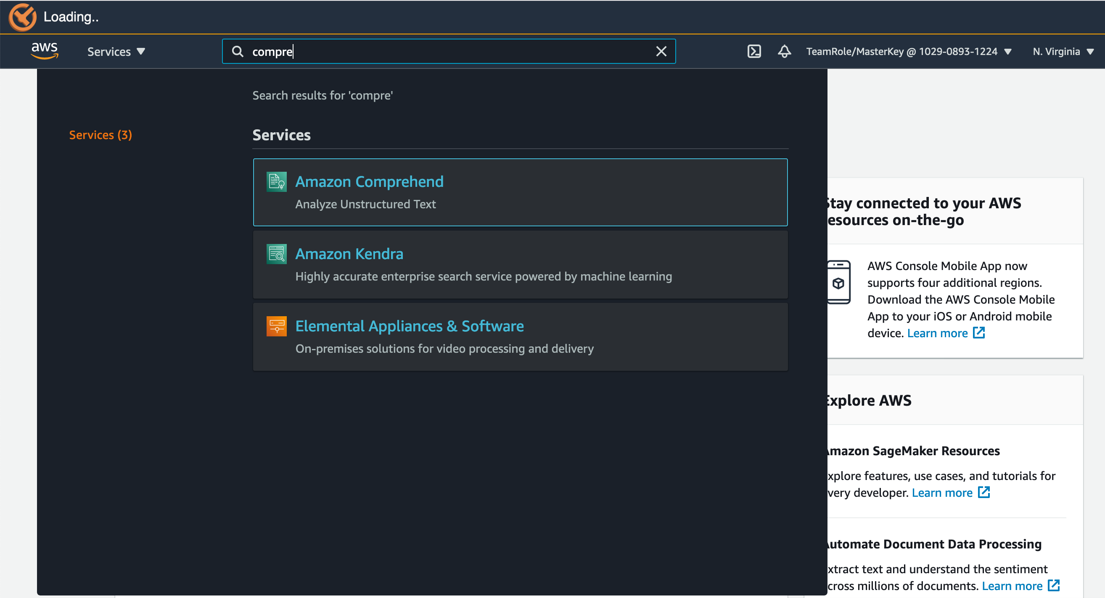
Type Comprehend and click to it

Slide 7
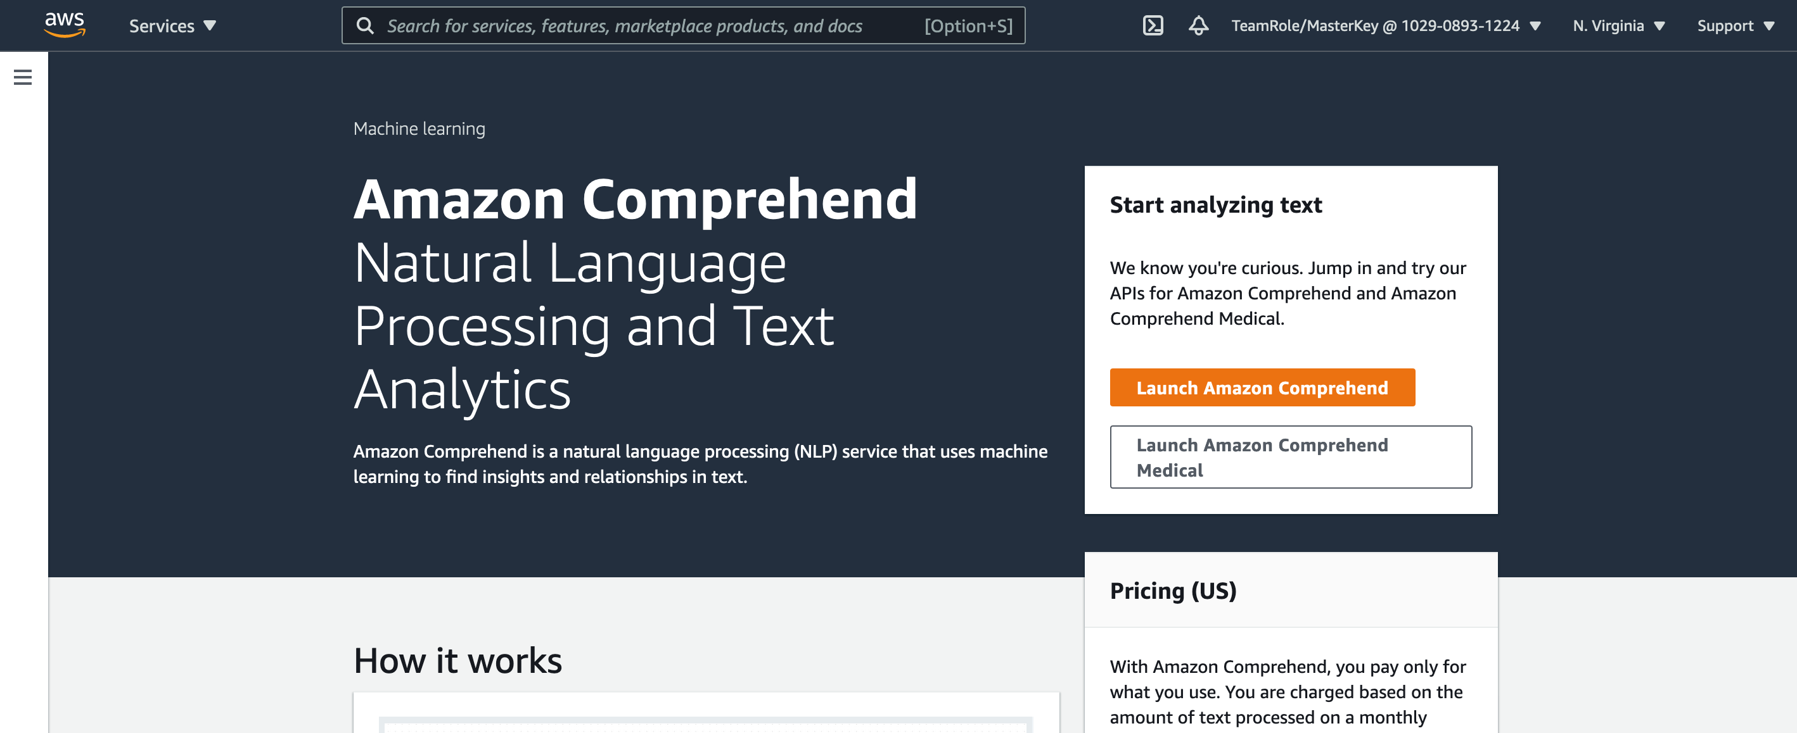
Click here

Slide 8
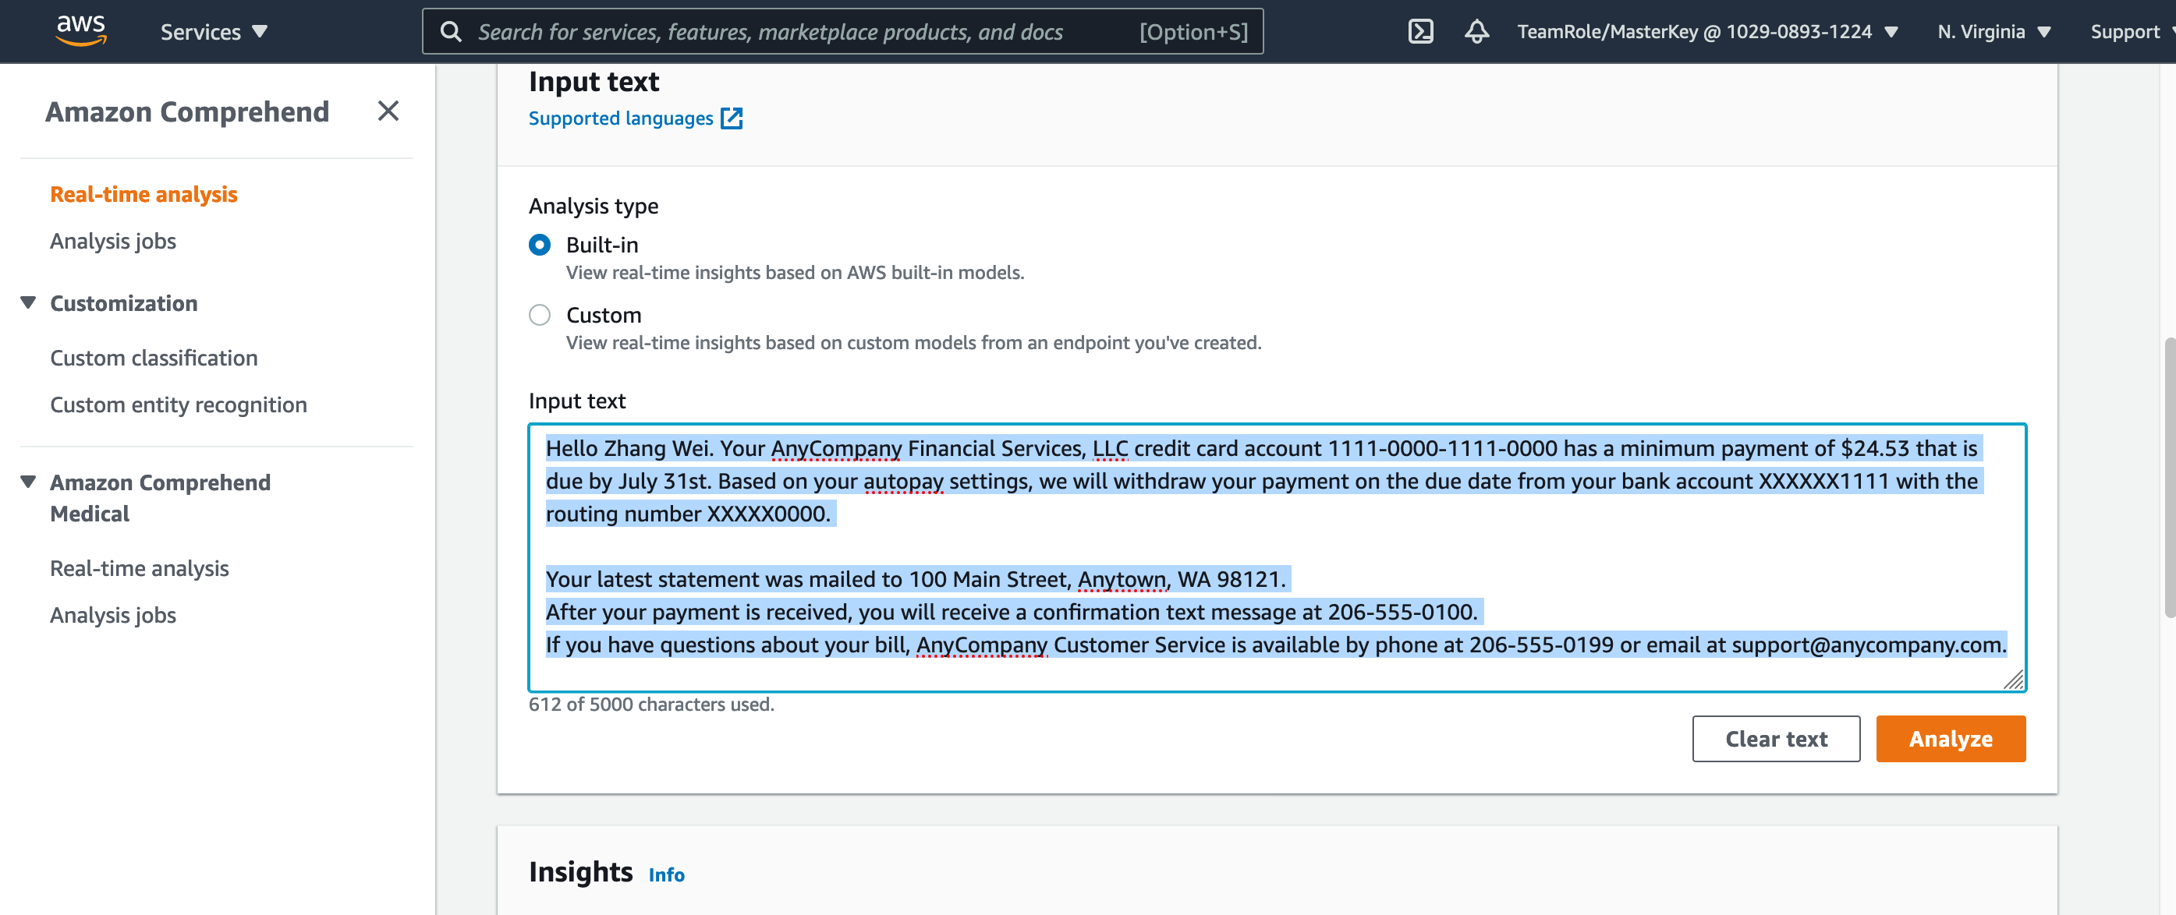
Go to “Real-time analysis” and Type your text
And click “Analyze” play with Insights

Slide 9
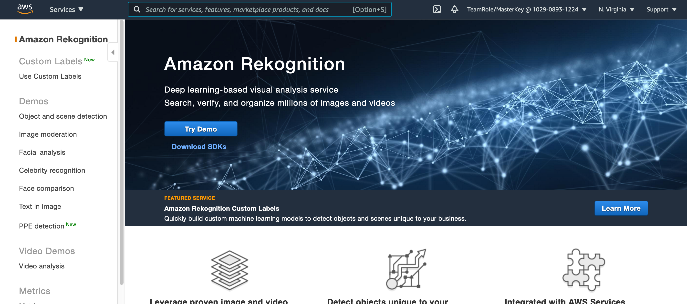
You can do the same with Amazon Rekogniton. Navigate to Amazon Rekognition on console
Try Demo!

Slide 10
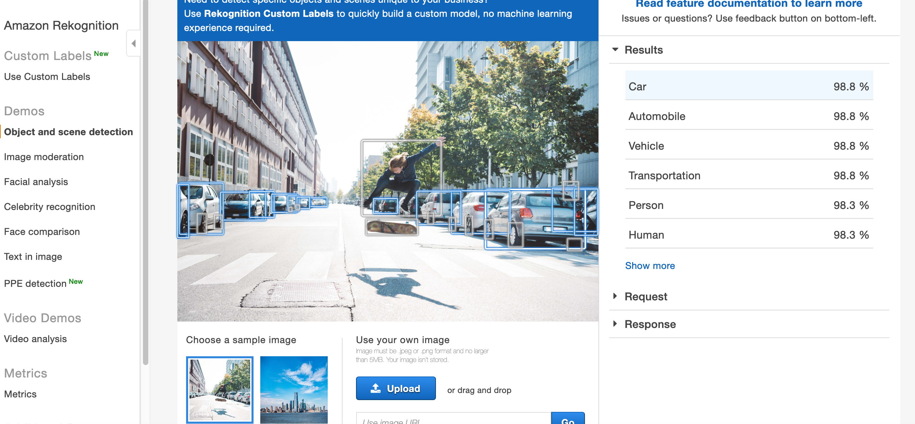

Slide 11
Other Managed Services to test
Polly
Lex
Translate
Transcribe

Slide 12
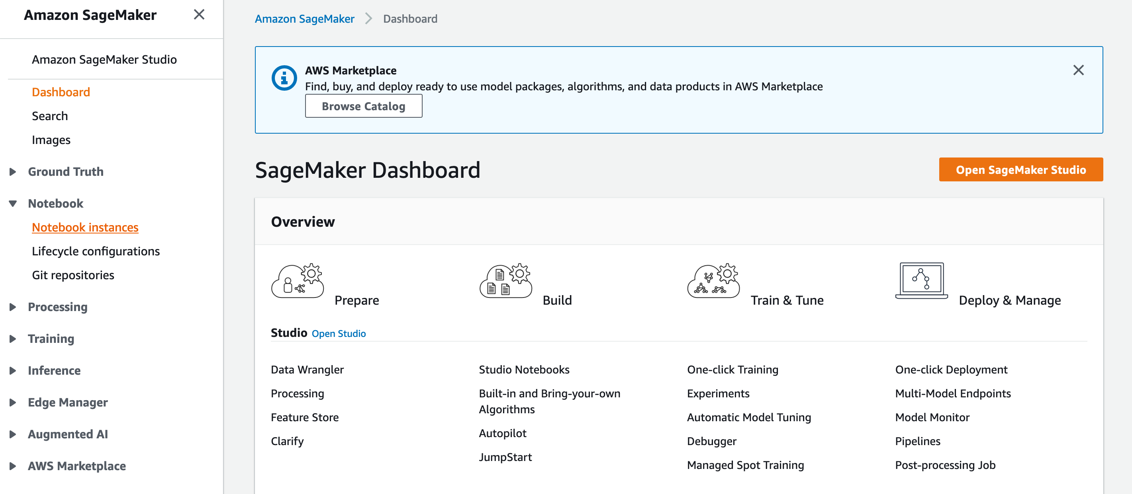
Sagemaker

Slide 13
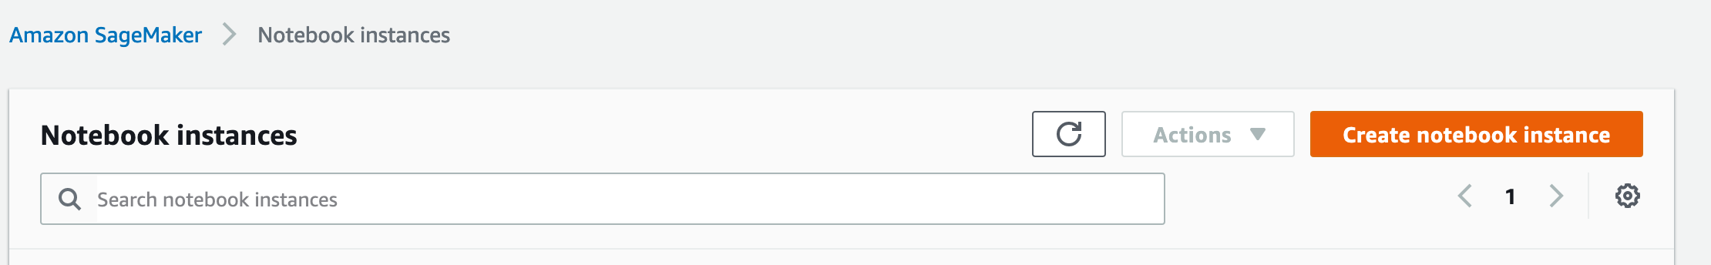

Slide 14
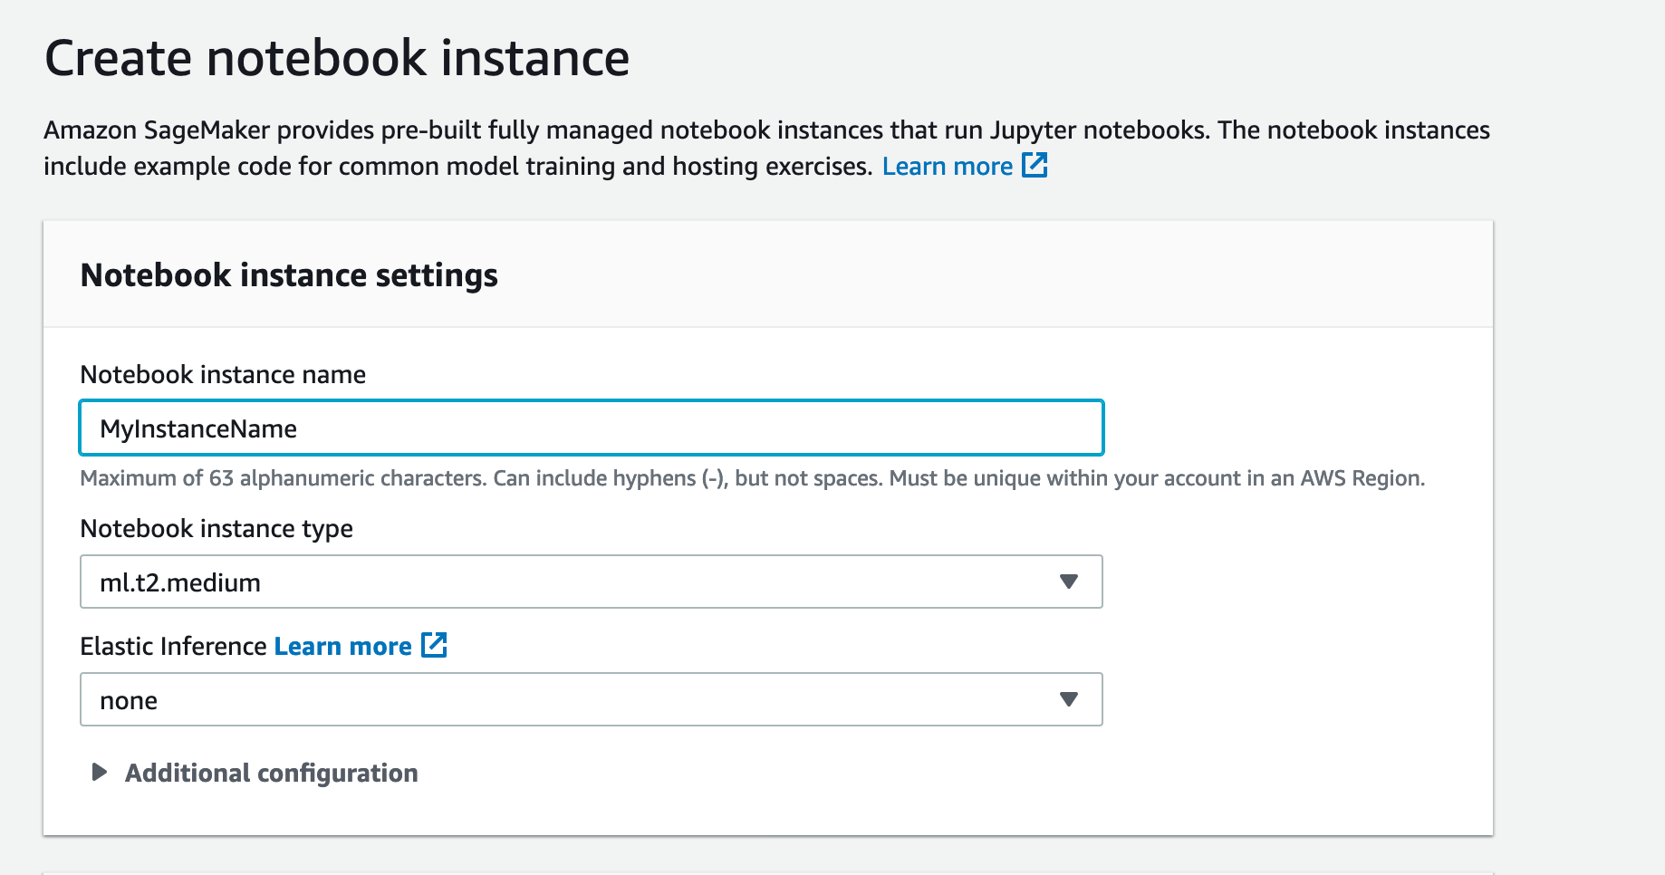
Enter any name

Slide 15
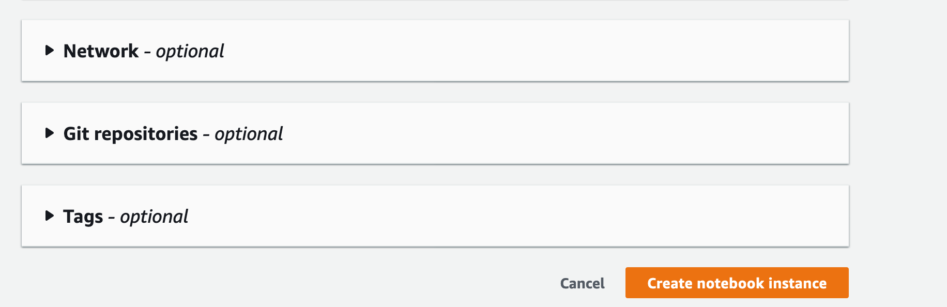

Slide 16
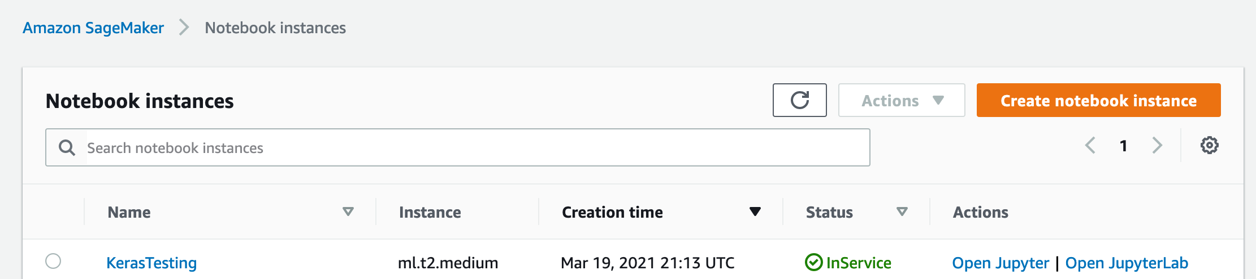
Status will be pending for a few minutes. Wait until it is InService

Slide 17
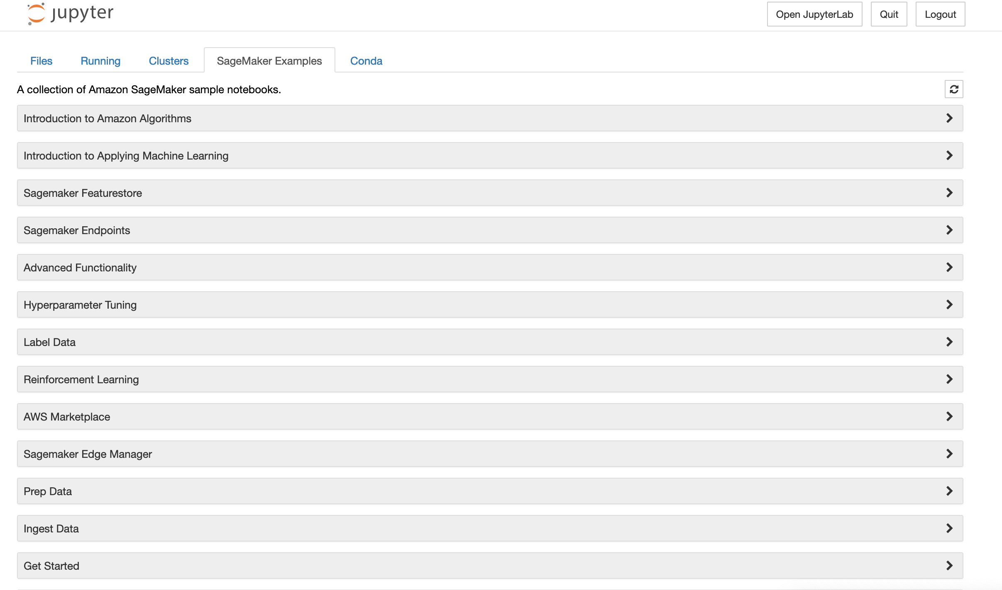

Slide 18
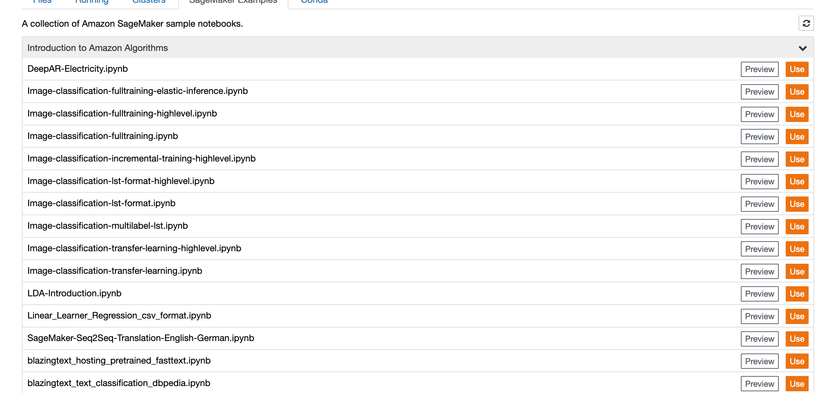
You can select any – click “Use”

Slide 19
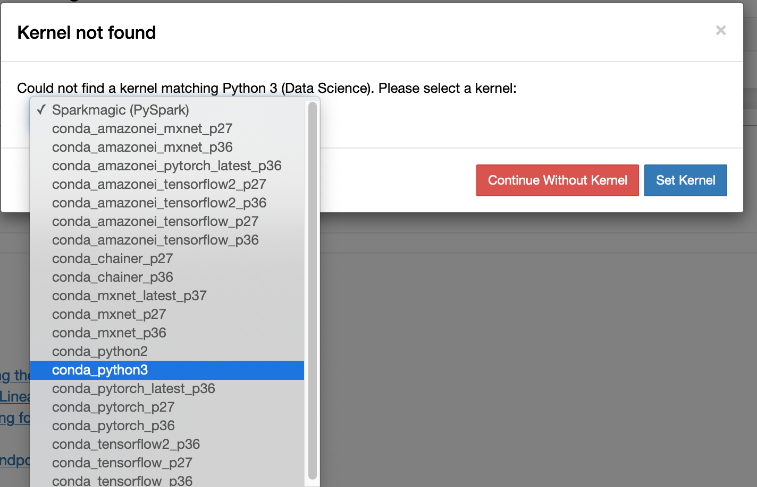
Select a kernel. For our case it was conda_python3
Things to learn:
Tensorfow???
MXNet???
What is conda???

Slide 20
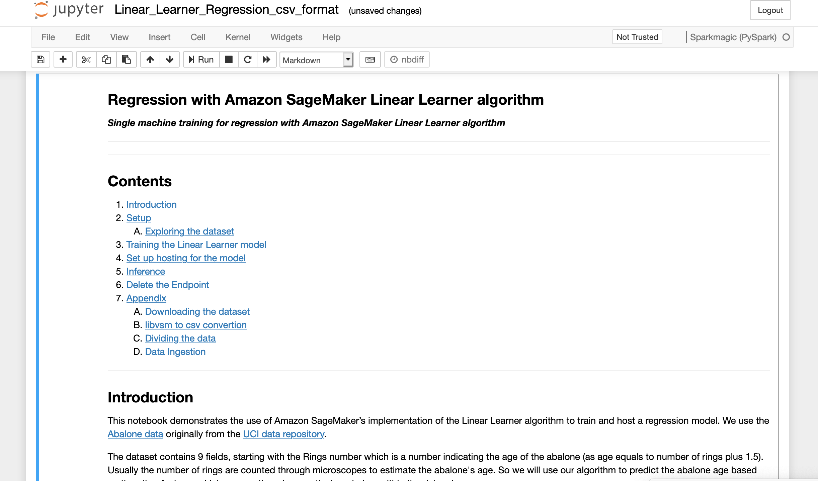
The example will walk with you

Slide 21
Other supporting materials
Check youtube videos. Search for “sagemaker examples” like “lenear learner”. For example, the use case I selected you can see this:
https://www.youtube.com/watch?v=pW6ETeF9_cE

Slide 22
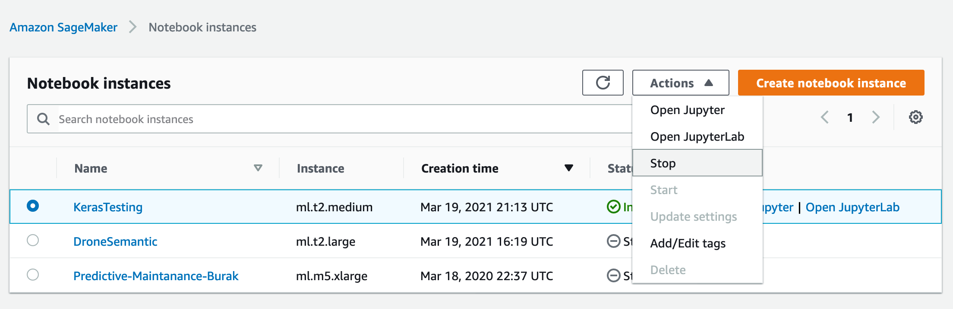
Please try to stop the instance when you are done and log out.
No worries about deleting the resources, after 48 hours it will be deleted

